Slide 1
Invoke:
How to be a
@task master
Charlotte
@pydatacharlotte
Rob Helgeson
Sr. Machine Learning Architect
Email: robhelgeson@hotmail.com
Twitter: @robhelgeson

Slide 2

Programming in a professional capacity for over 20 years in a variety of languages
Currently full stack Typescript & Python
I have only been using Python for less than a year, so be ready to proofread
A part of the Advanced Analytics team @ American Tire Distributors to help revolutionize an industry full of “gut analytics”
Who am I?
Rob Helgeson
PyData Charlotte | Invoke: How to be a @task Master

Slide 3
What Invoke is and when to use it
What the @task decorator is and its usage
What is the context argument of all @tasks
How to supply options to @tasks
How to bring structure to @tasks
Use case: Pipelines and apps in Docker
Use case: Invoke to manage a monorepo
Use case: Invoke as a CLI in your package
Topics
What are we covering?
PyData Charlotte | Invoke: How to be a @task Master

Slide 4
What is Invoke?
A small library to bridge python and the command line
A better way to structure runnable commands (tasks)
A make-like task dependency management tool
A customizable CLI for use in in your own package
A rich argument parsing system
PyData Charlotte | Invoke: How to be a @task Master

Slide 5
Why Invoke?
Why Not Invoke?
Repeatable and consistent
Flexible with command line arguments
Access to application context
Commands in source control
Dependency management
Nothing run from the command line
No configuration options
Smaller project
You love Makefile and bash scripting …more than python
PyData Charlotte | Invoke: How to be a @task Master

Slide 6
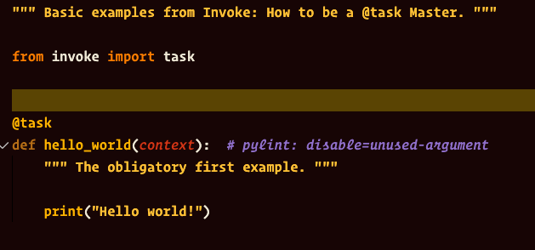
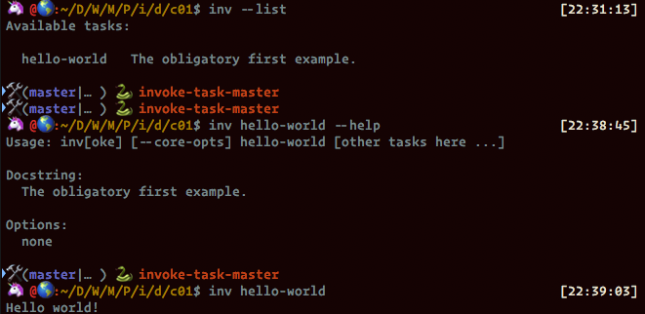
How do I use Invoke?
pip install invoke
New command: invoke or inv for short
Looks for tasks.py in pwd
inv --help or inv --list
Get help on inv or your tasks
source <(inv --print-completion-script zsh)
Tab completion for your shell
PyData Charlotte | Invoke: How to be a @task Master

Slide 7
What is a Task?
Any command that you wish to run
Implemented as a python function
Decorated with @task
PyData Charlotte | Invoke: How to be a @task Master

Slide 8
DEMO 01
Anatomy of @tasks
PyData Charlotte | Invoke: How to be a @task Master

Slide 9
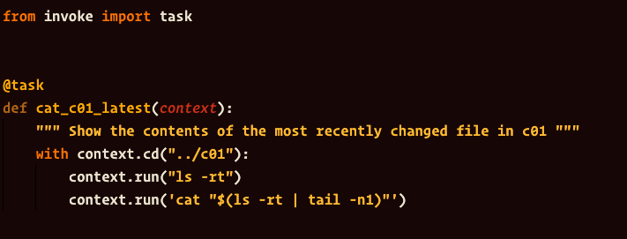
What is that context argument?
First argument of all @task functions
Provides a wrapper to some system commands, such as: cd, run, sudo
Gathers settings in a single object
PyData Charlotte | Invoke: How to be a @task Master

Slide 10
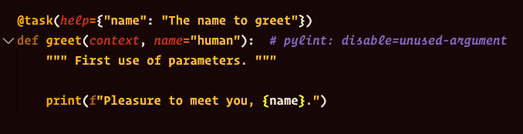
What about command options?
Yes! In several ways
Boolean
String
Numeric
Lists
PyData Charlotte | Invoke: How to be a @task Master

Slide 11
DEMO 02
Options for @tasks
PyData Charlotte | Invoke: How to be a @task Master

Slide 12
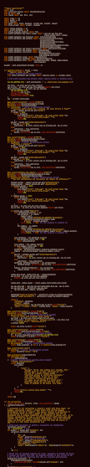
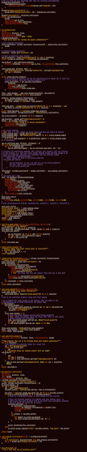
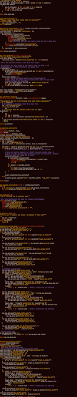
What about at scale?
Too many tasks in a single file
More complex projects
Larger teams
What if a name is already used?
Invoke will take care of naming
Except where it can’t…
tasks.py too long!
PyData Charlotte | Invoke: How to be a @task Master

Slide 13
pipeline
Use Namespaces
Divide your tasks logically
Use Invoke’s ability to rename tasks
calcs
reports
PyData Charlotte | Invoke: How to be a @task Master

Slide 14
DEMO 03
Structure to @tasks
PyData Charlotte | Invoke: How to be a @task Master

Slide 15
Use Cases
How I use invoke
&
Choose your own adventure
PyData Charlotte | Invoke: How to be a @task Master

Slide 16
Docker
Embedded
Monorepo
Run tasks from docker
Pipelines with apps
Automatic update
Can be cron’d
Re-brand invoke
Use as your own CLI
Ships with your package
Manage code & tests
Manage deployments
Ensure consistency
PyData Charlotte | Invoke: How to be a @task Master

Slide 17
Questions?
PyData Charlotte | Invoke: How to be a @task Master
Notes:
Add PyData handles
Add code context images
Add to best practices:
add requirements.txt file

Slide 18

Sources used
http://www.pyinvoke.org
https://github.com/pyinvoke/invoke
http://docs.pyinvoke.org/en/1.3/index.html

